Slide 1
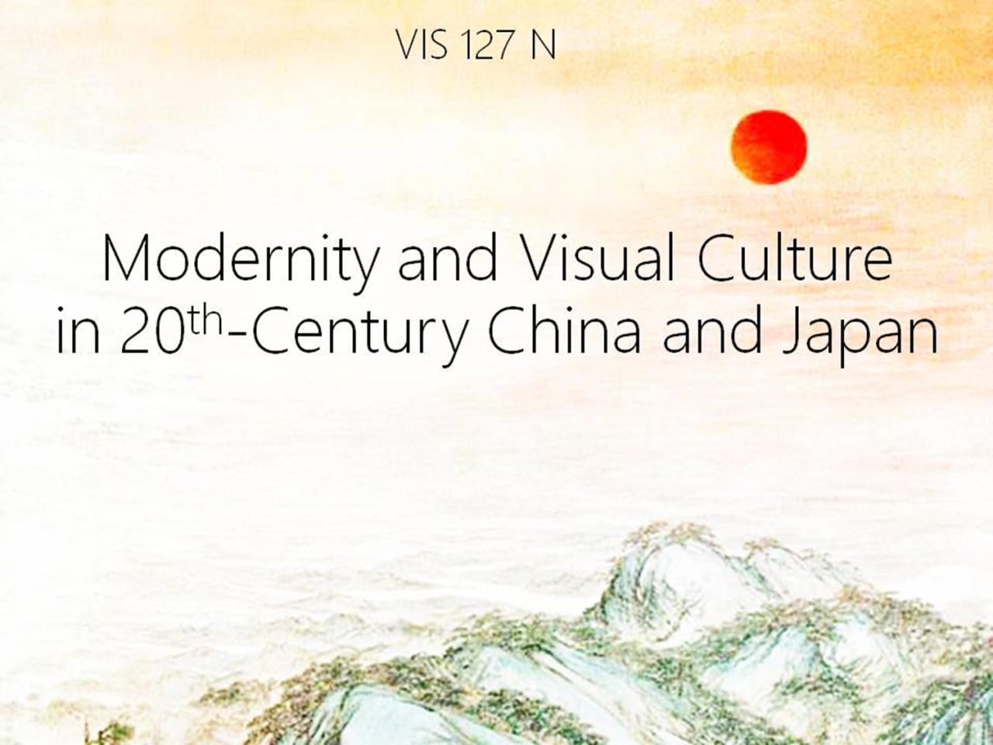

Slide 2

October 1917

Slide 3
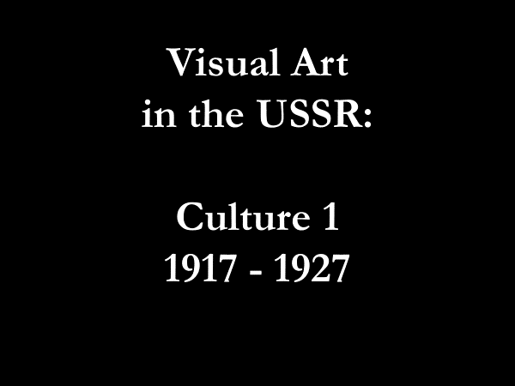

Slide 4
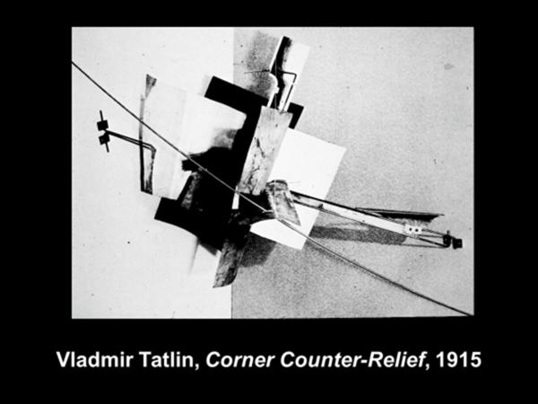

Slide 5
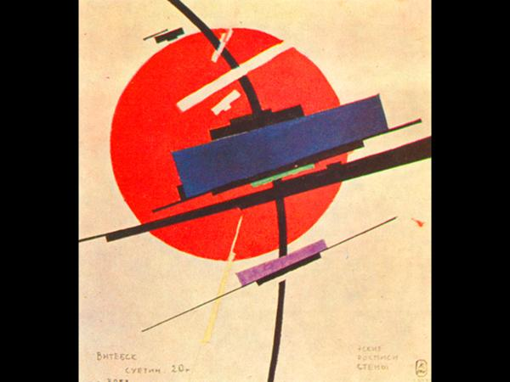

Slide 6
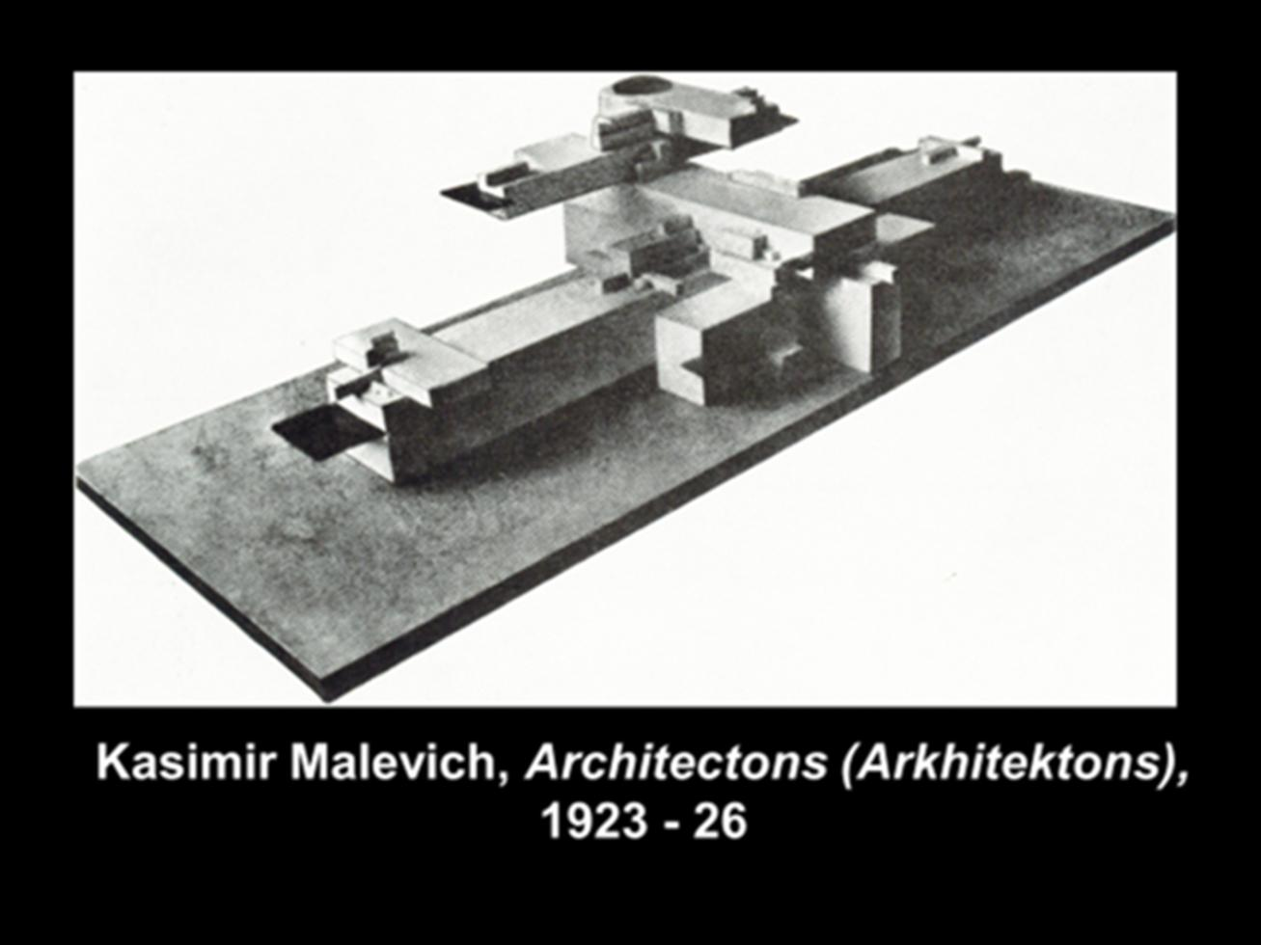

Slide 7
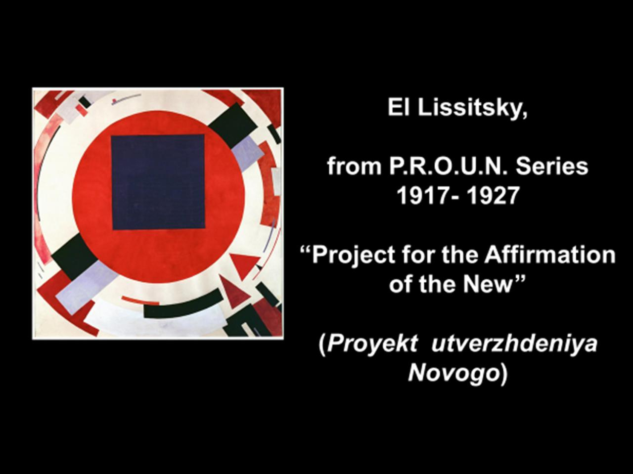

Slide 8
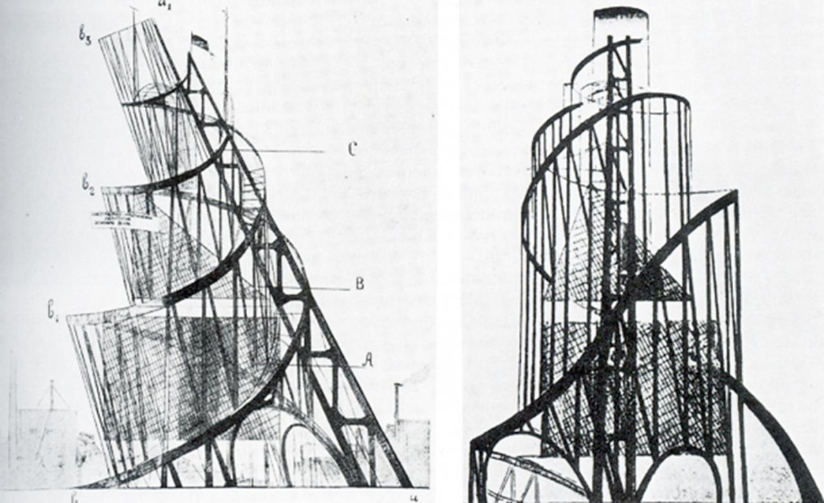

Slide 9
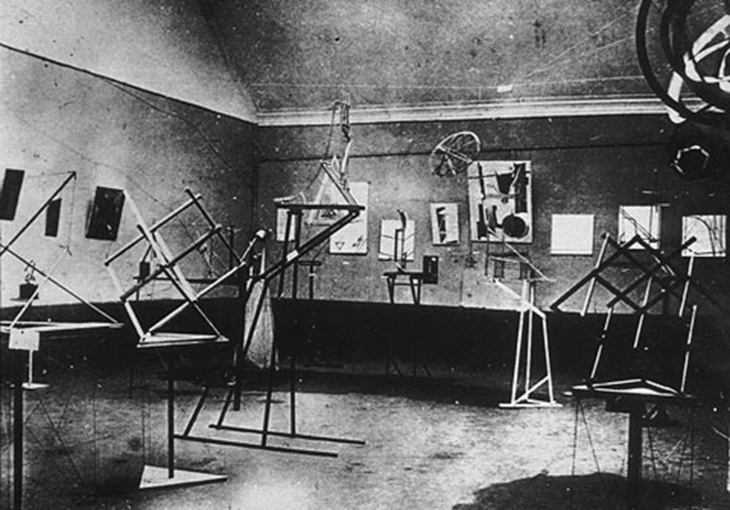

Slide 10
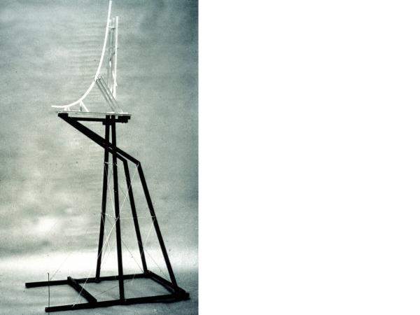

Slide 11
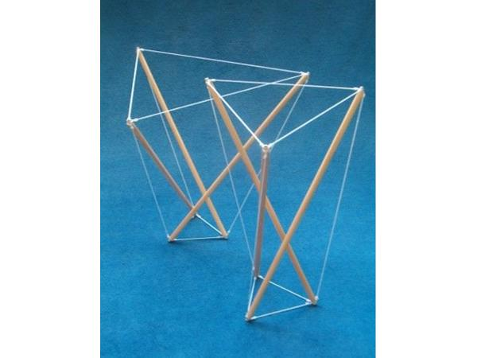

Slide 12
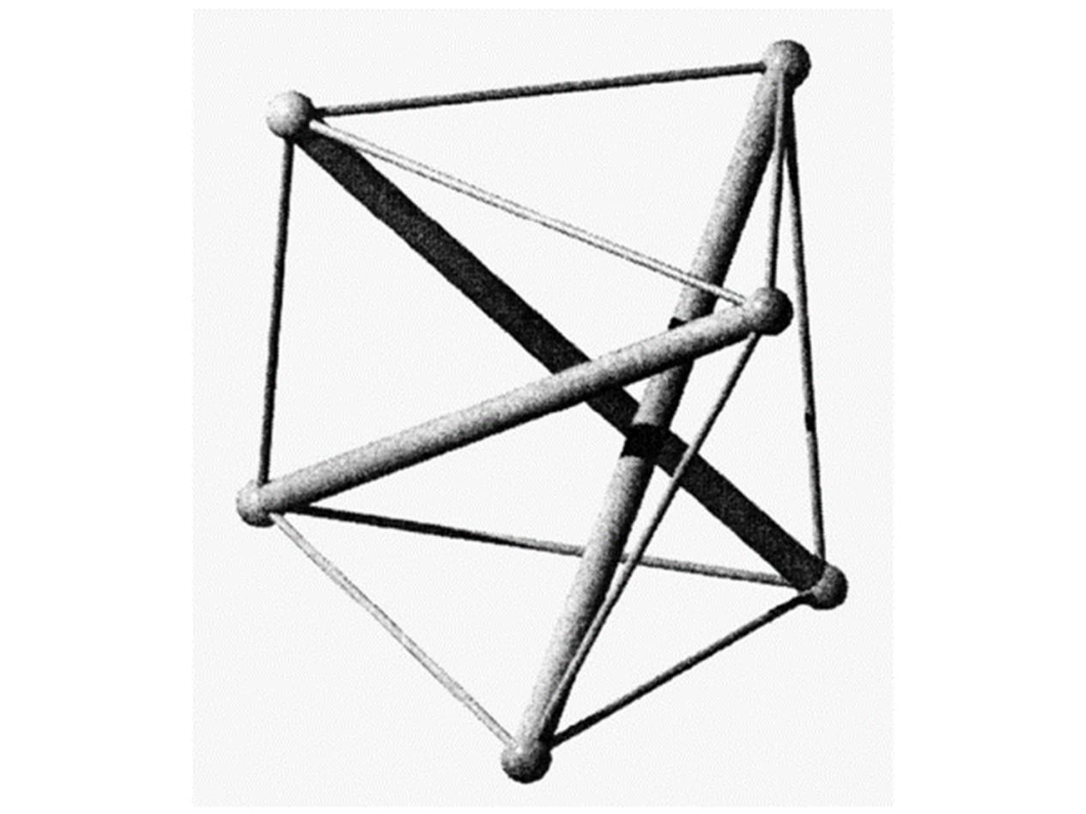

Slide 13
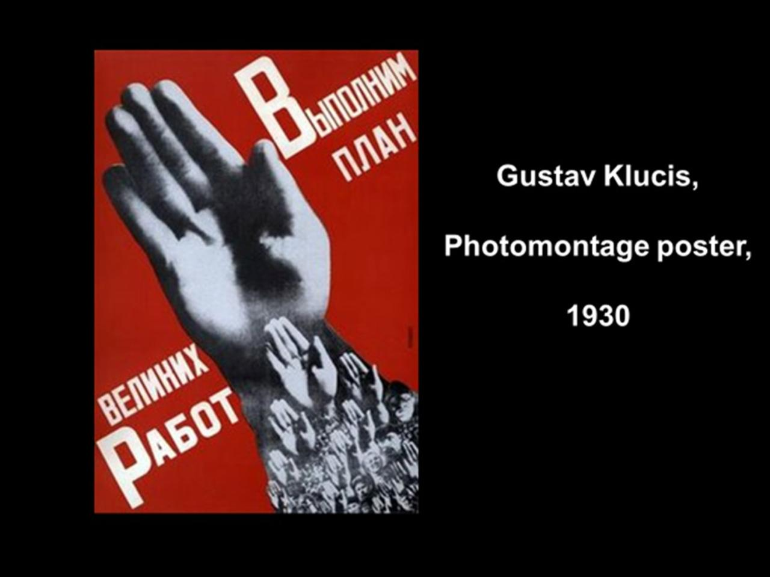

Slide 14
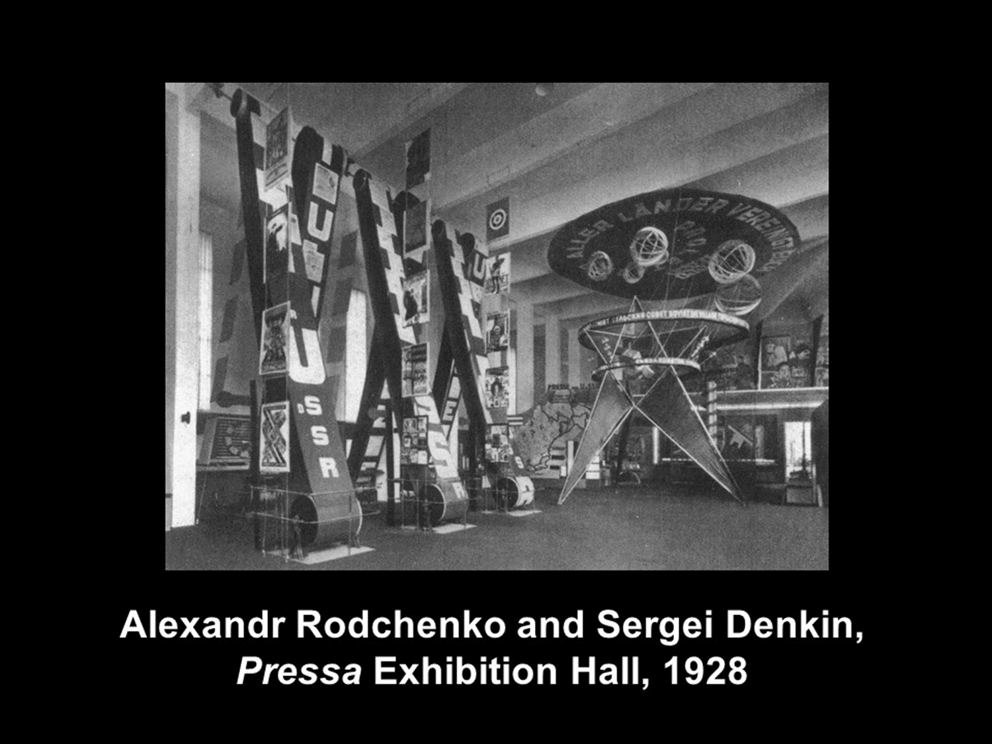

Slide 15
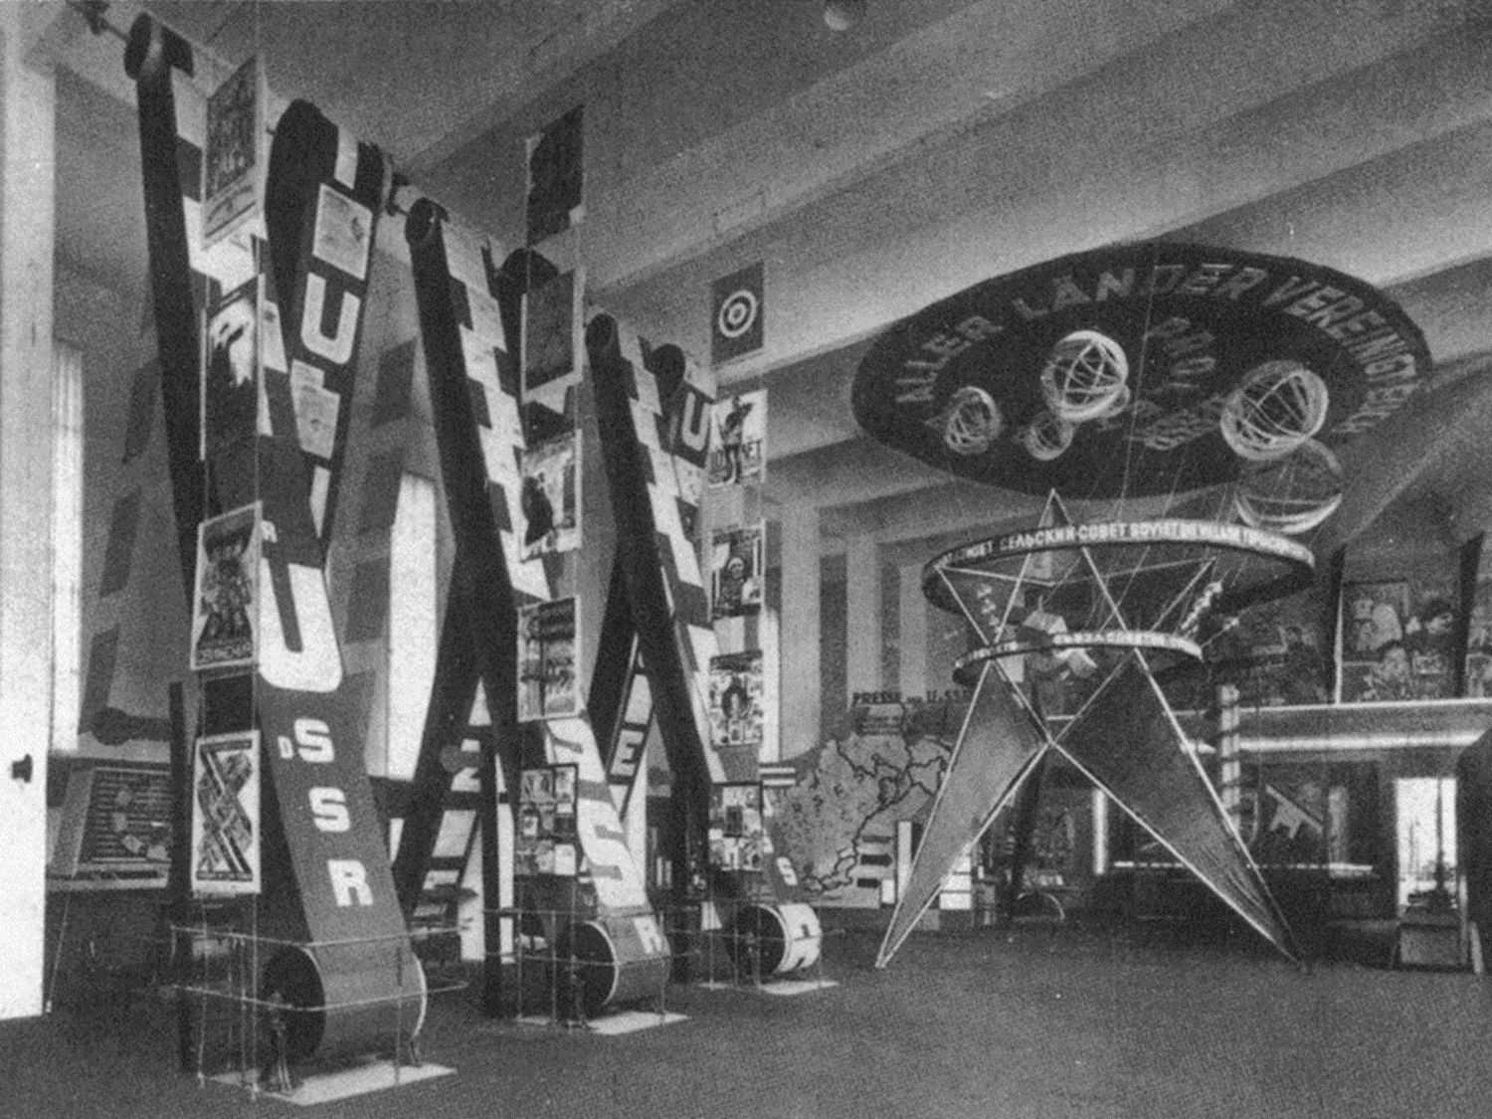

Slide 16
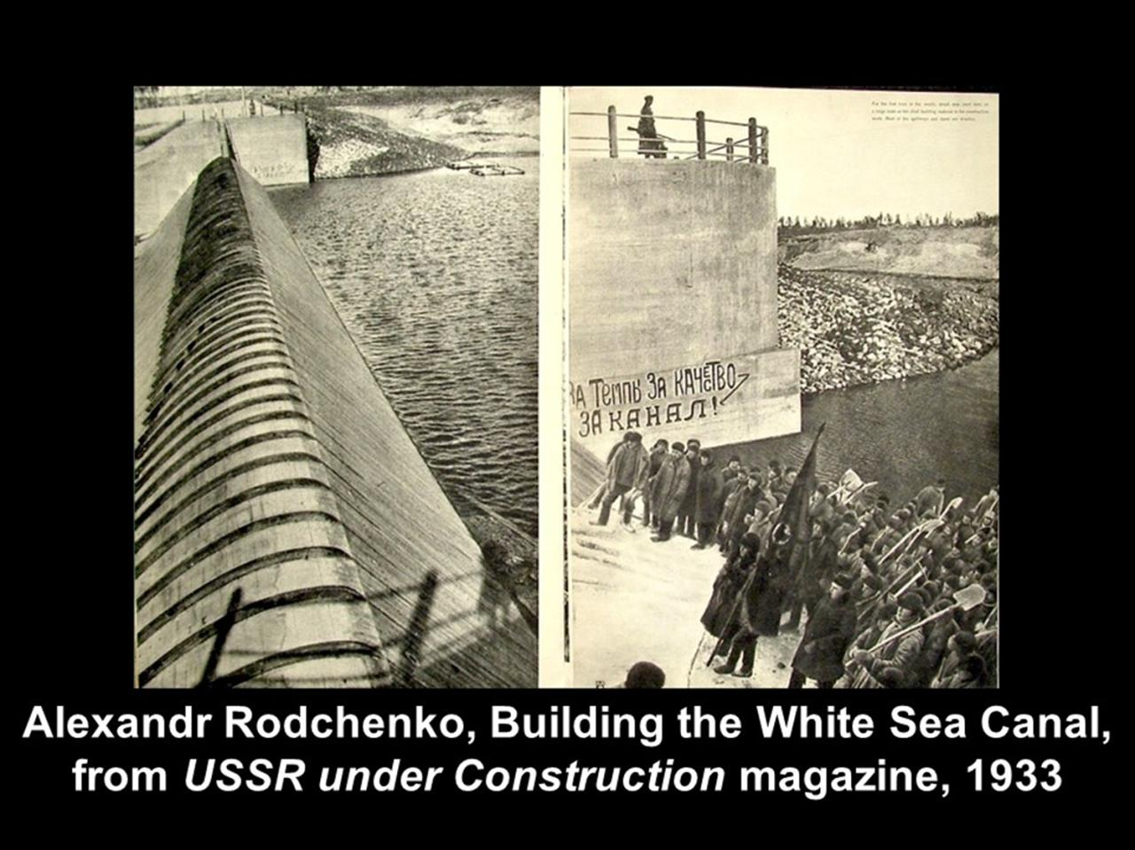

Slide 17
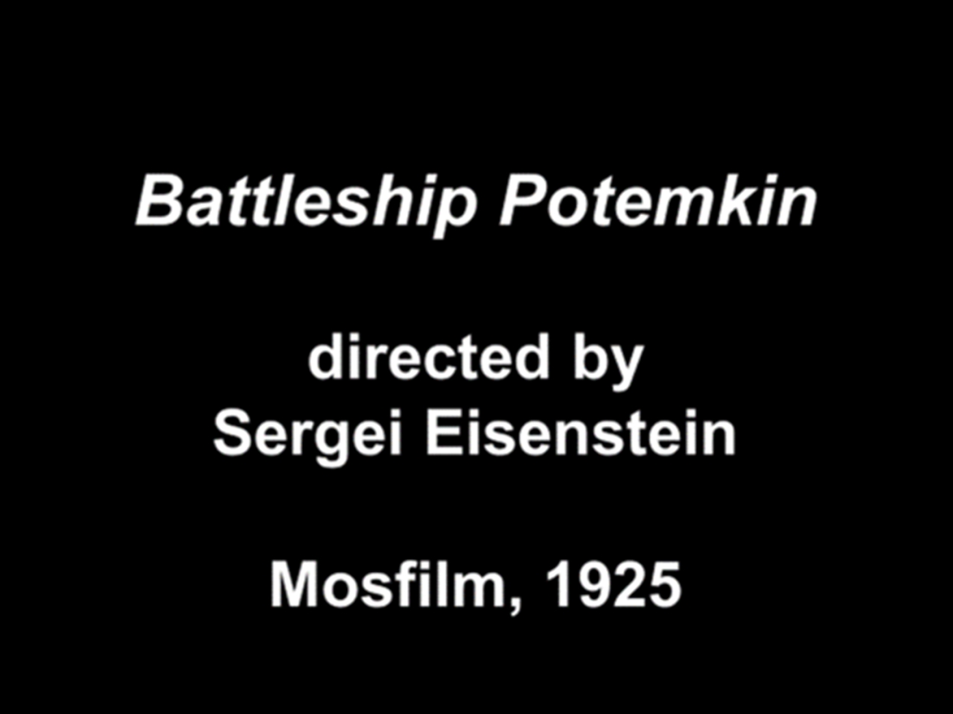

Slide 18
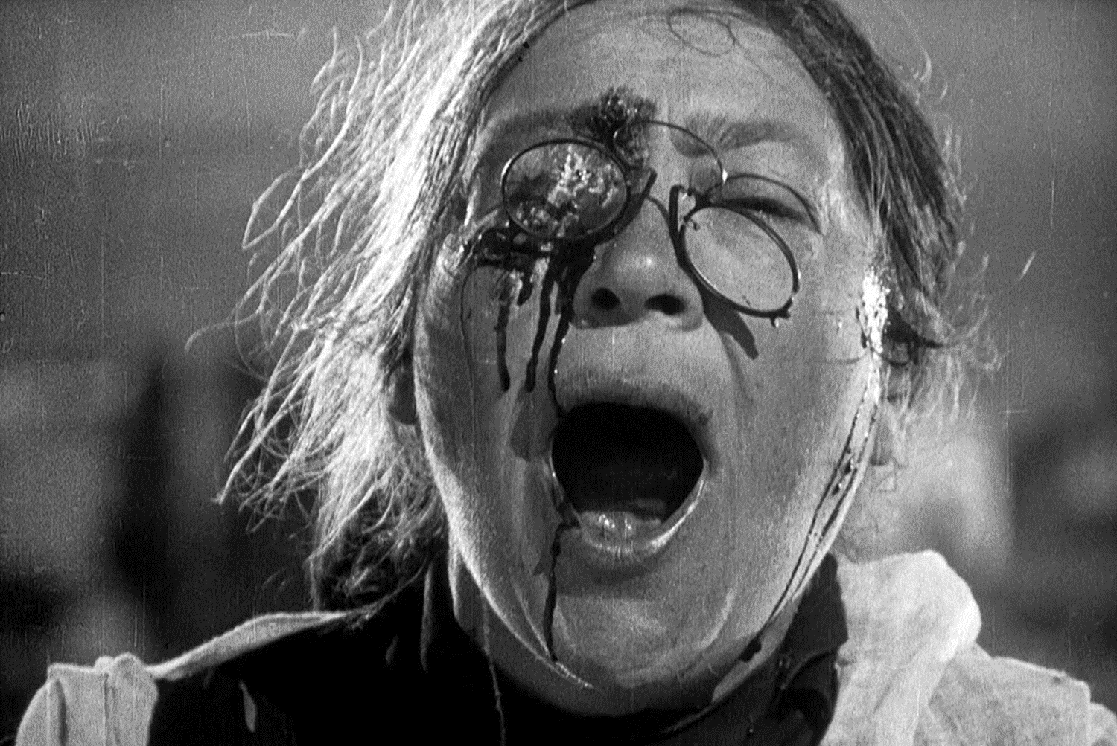

Slide 19
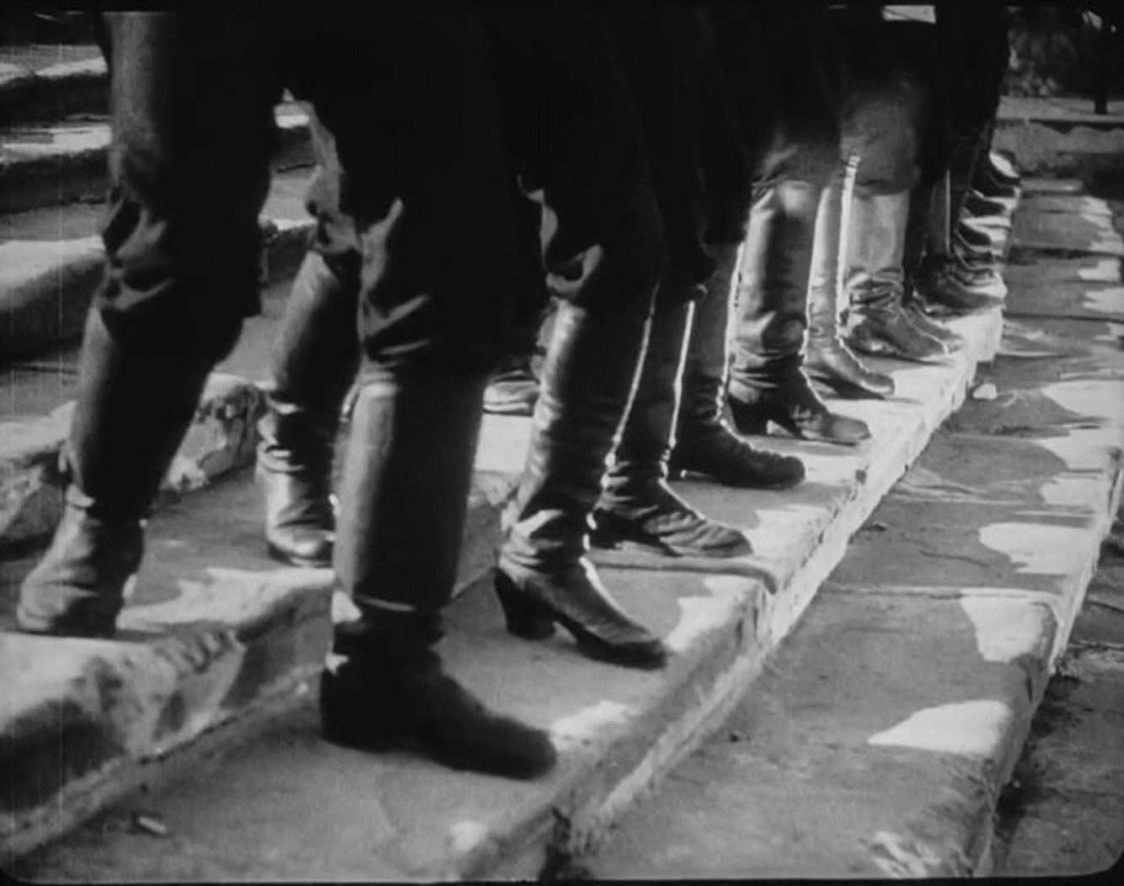

Slide 20
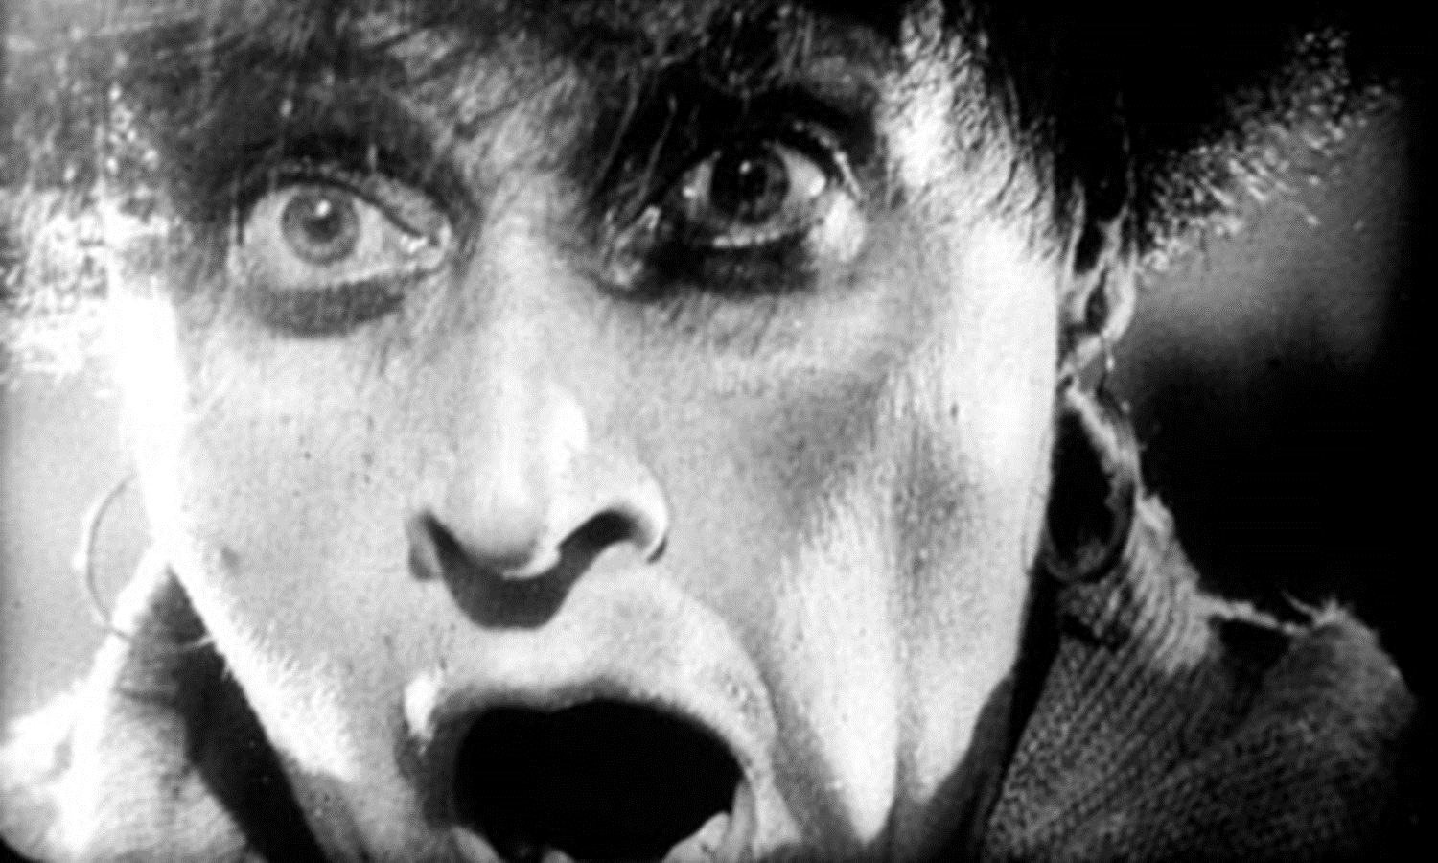


Slide 21
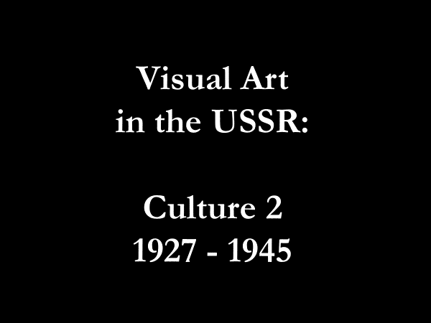

Slide 22
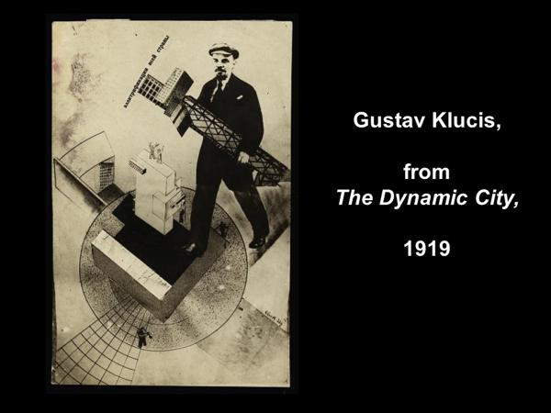

Slide 23


Slide 24


Slide 26


Slide 27
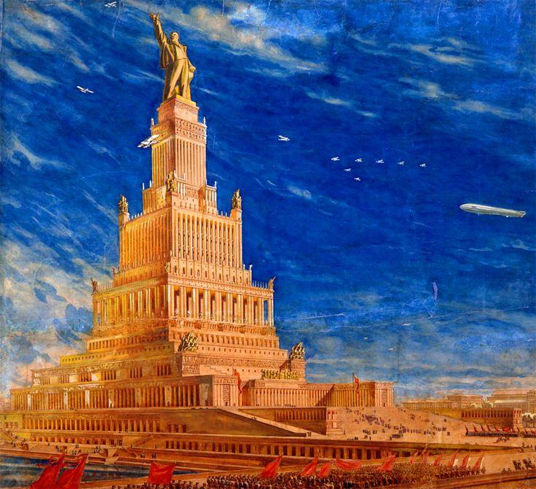

Slide 28
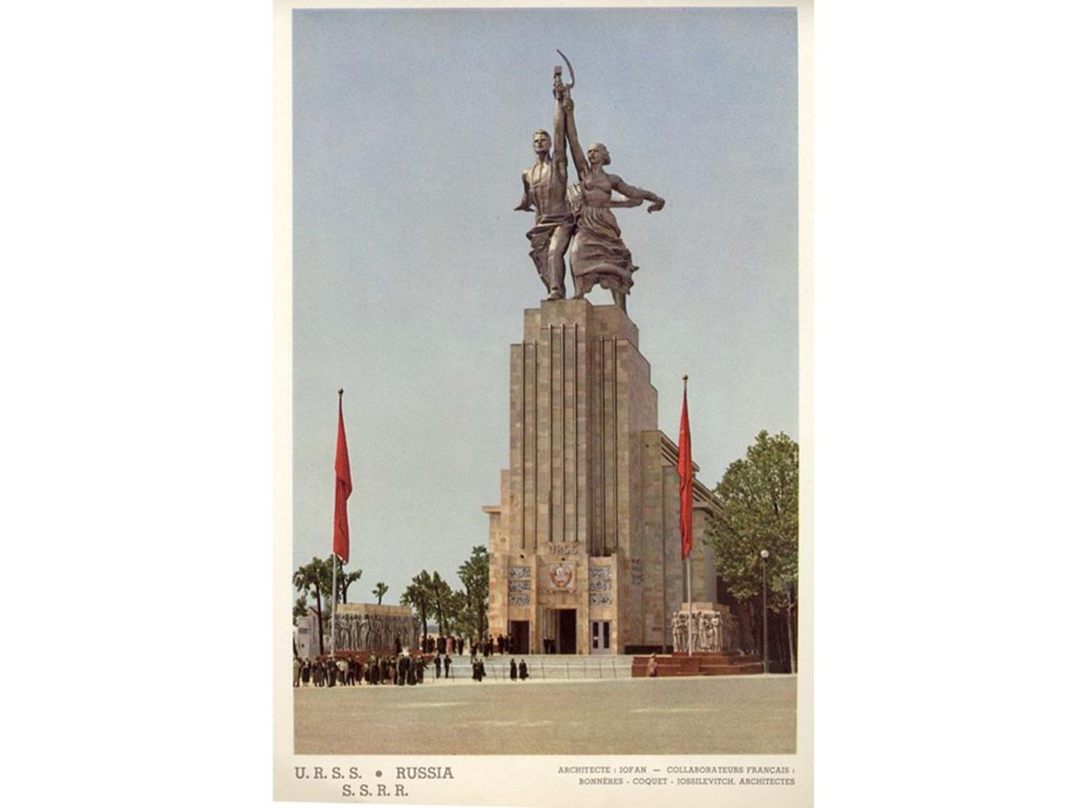

Slide 29
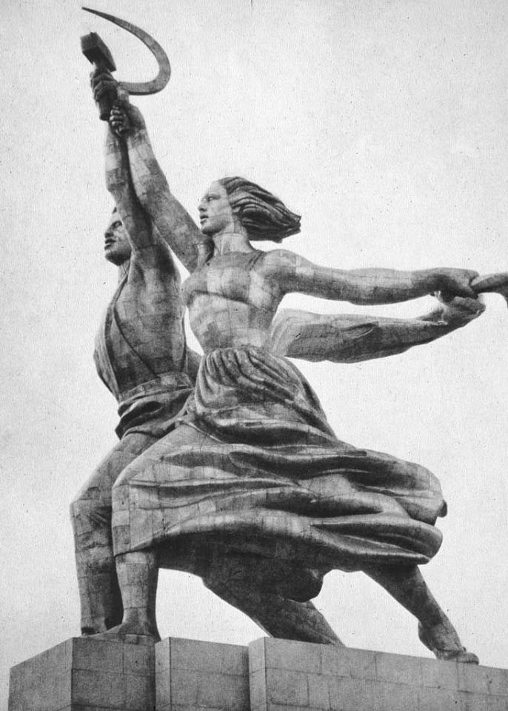

Slide 30

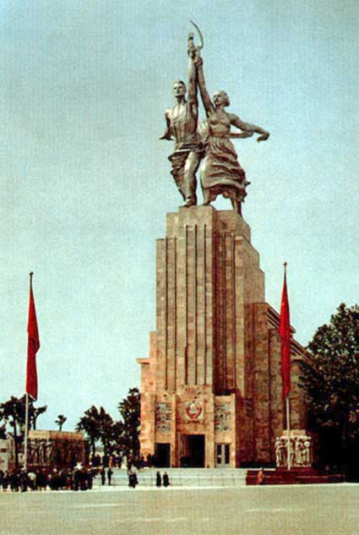

Slide 31
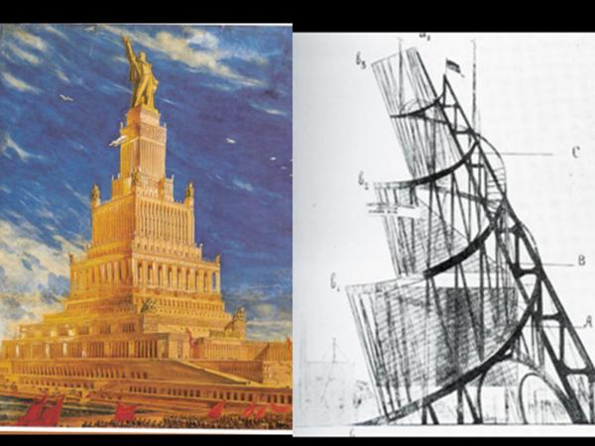

Slide 32
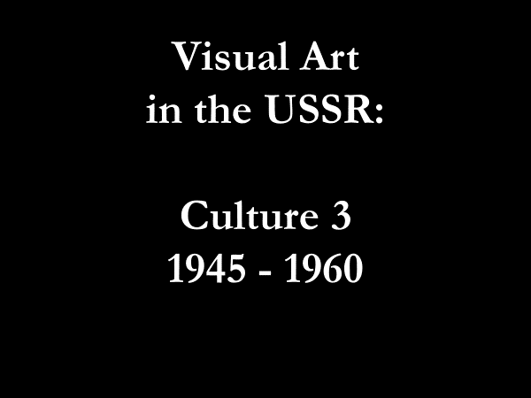

Slide 33
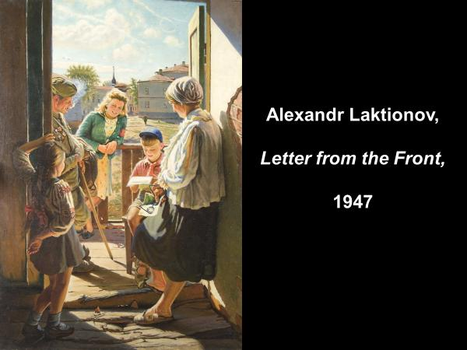

Slide 34
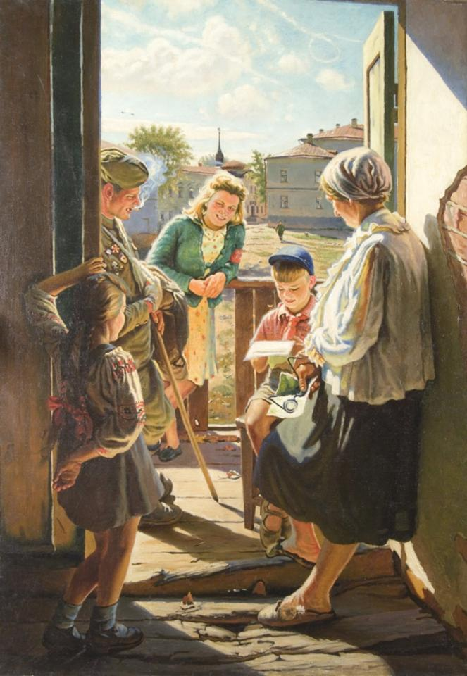

Slide 36
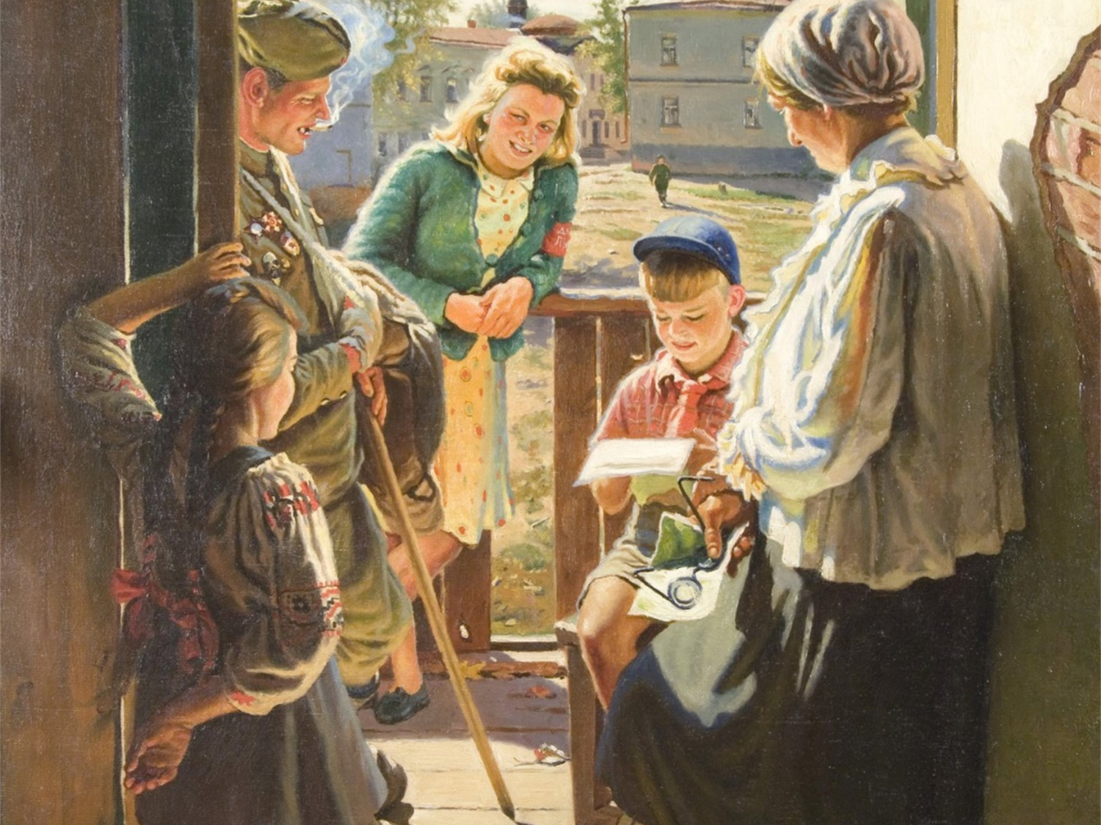

Slide 37
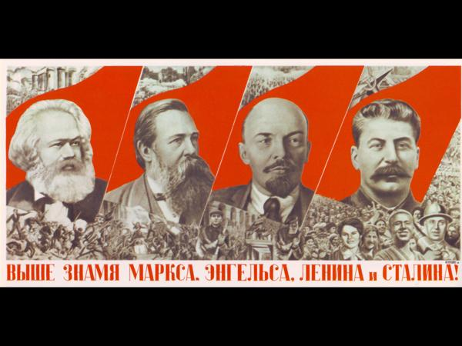

Slide 38
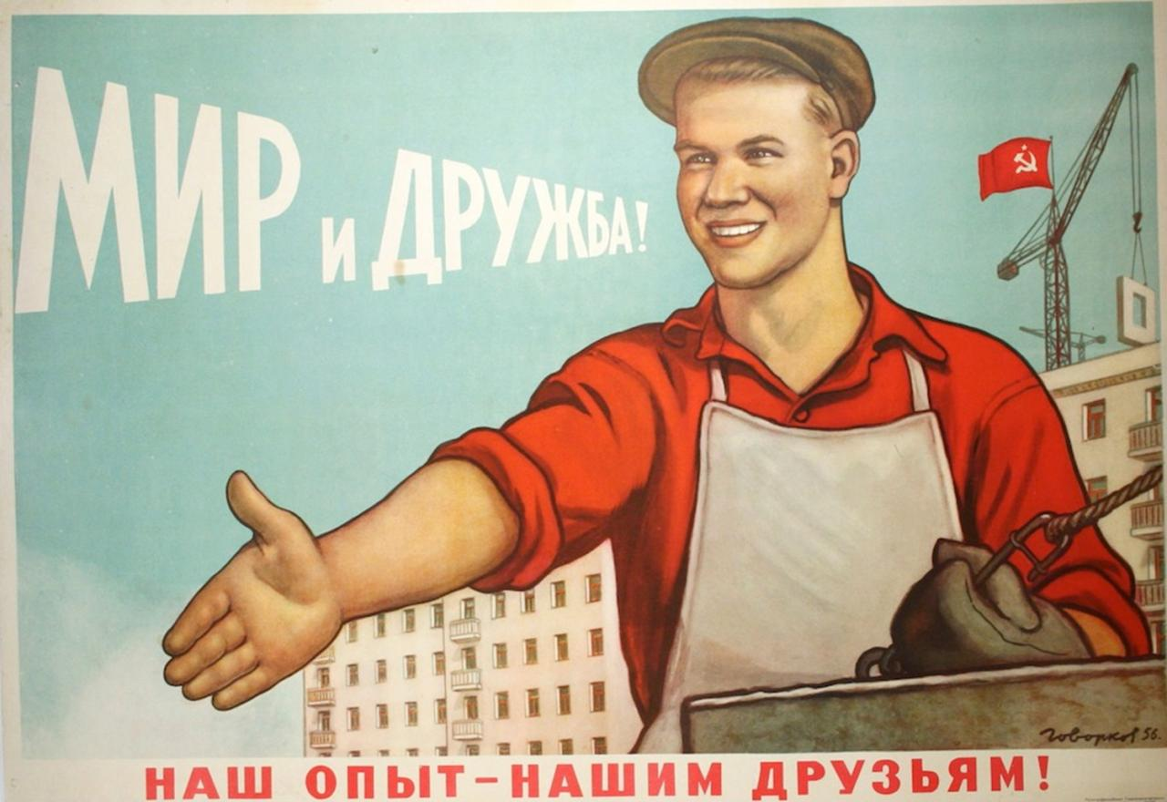

Slide 39
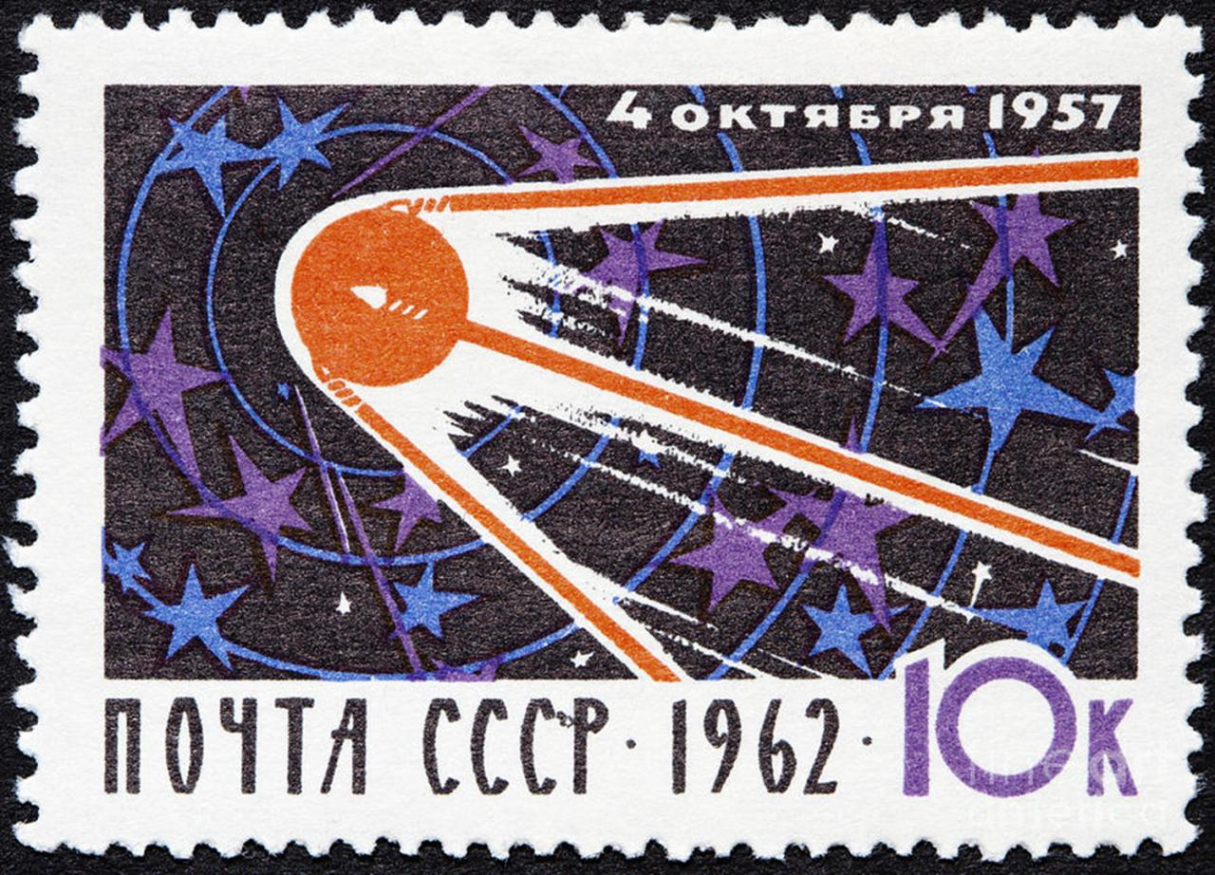

Slide 40
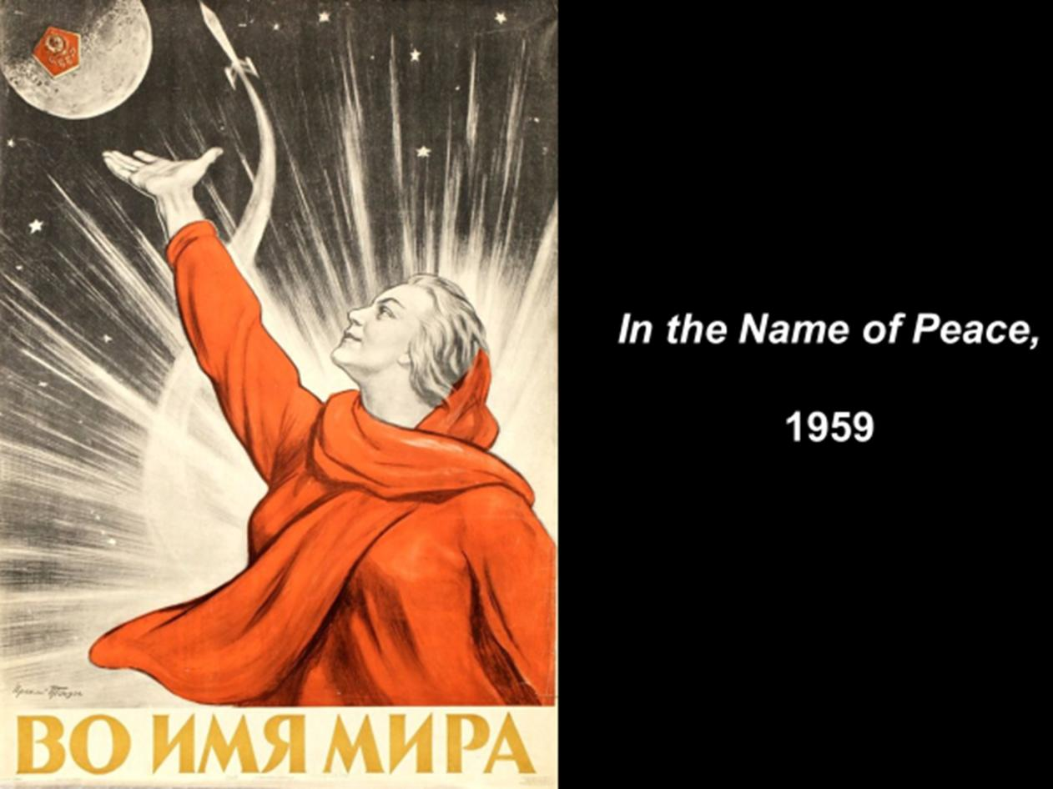

Slide 41
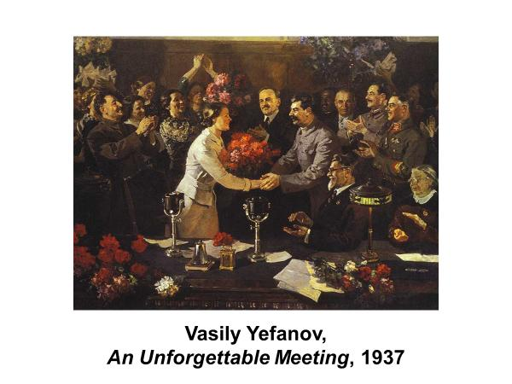

Slide 42
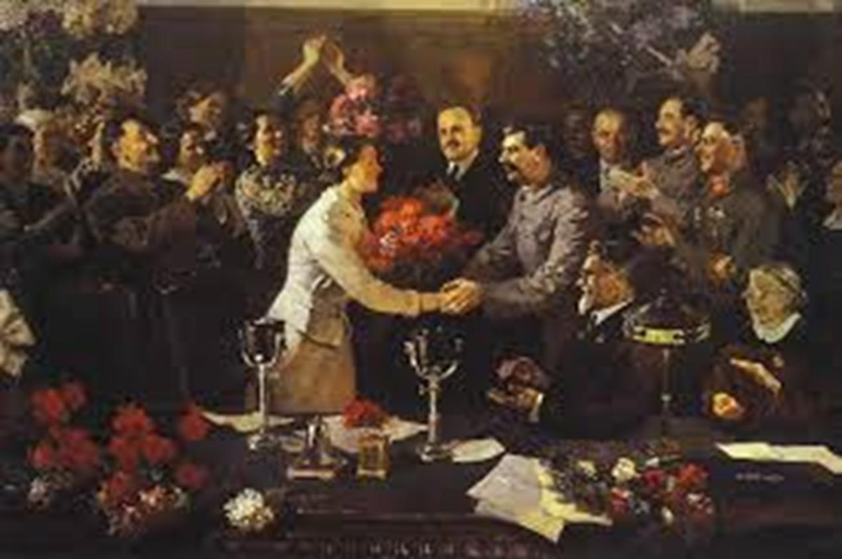

Slide 43
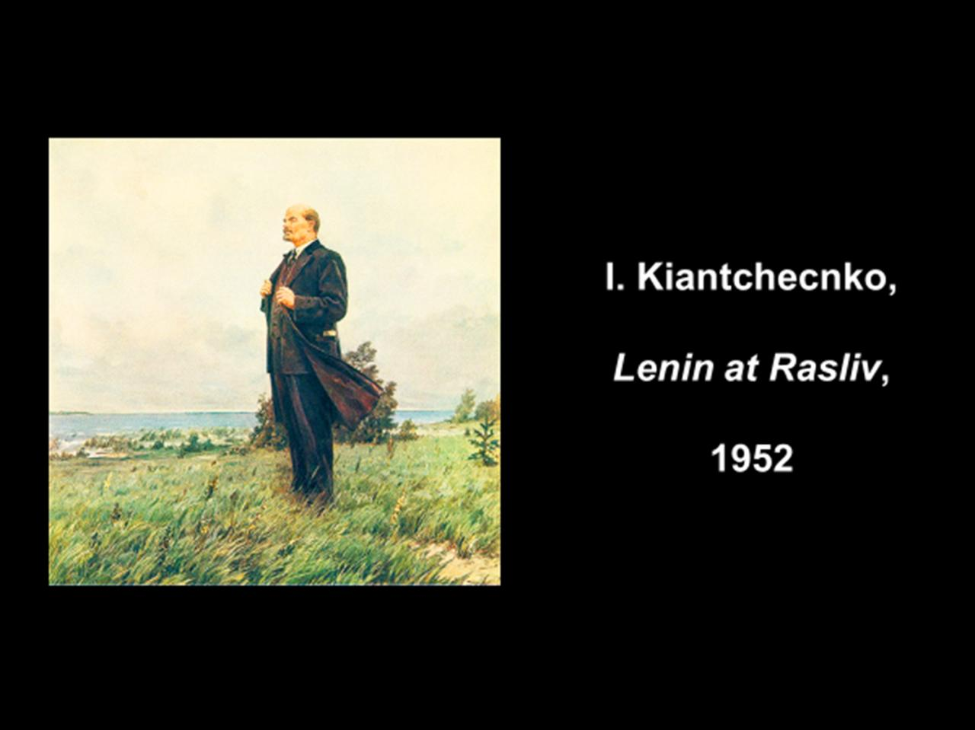

Slide 44
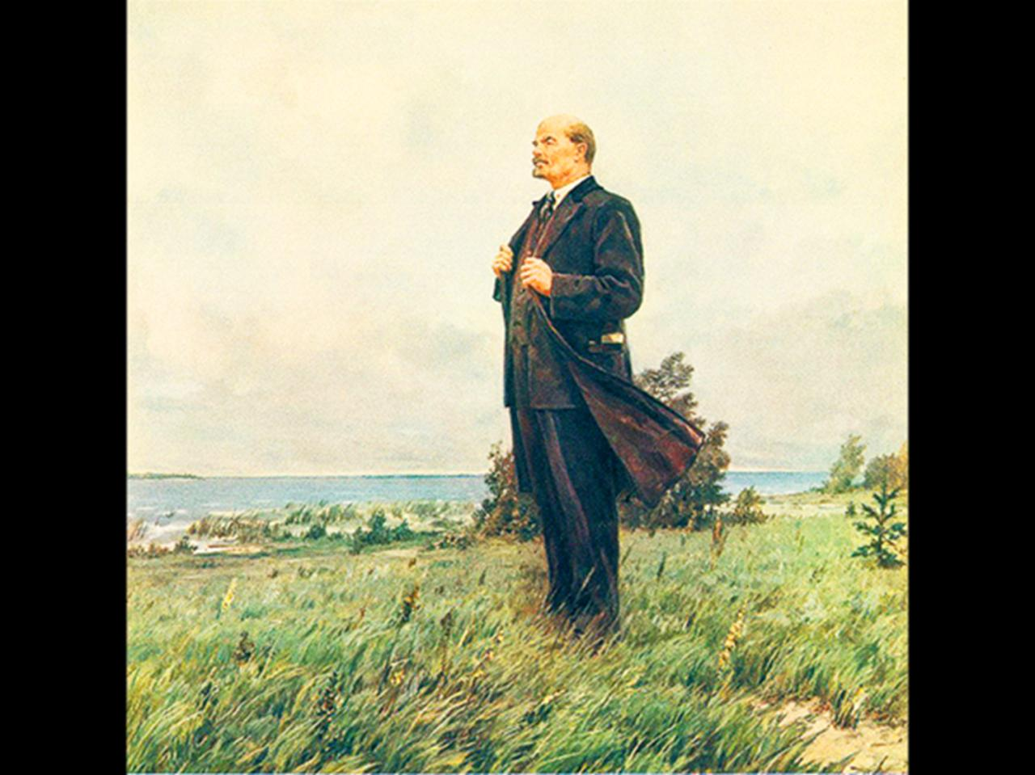

Slide 45
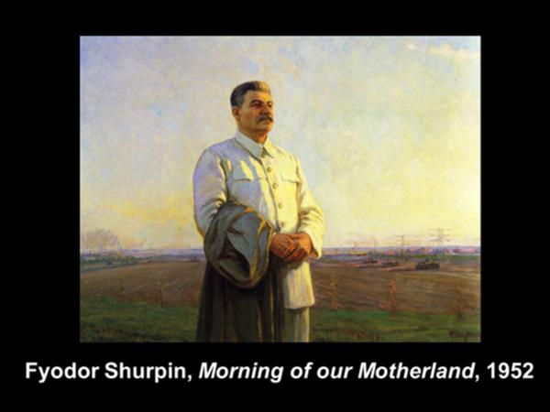

Slide 46
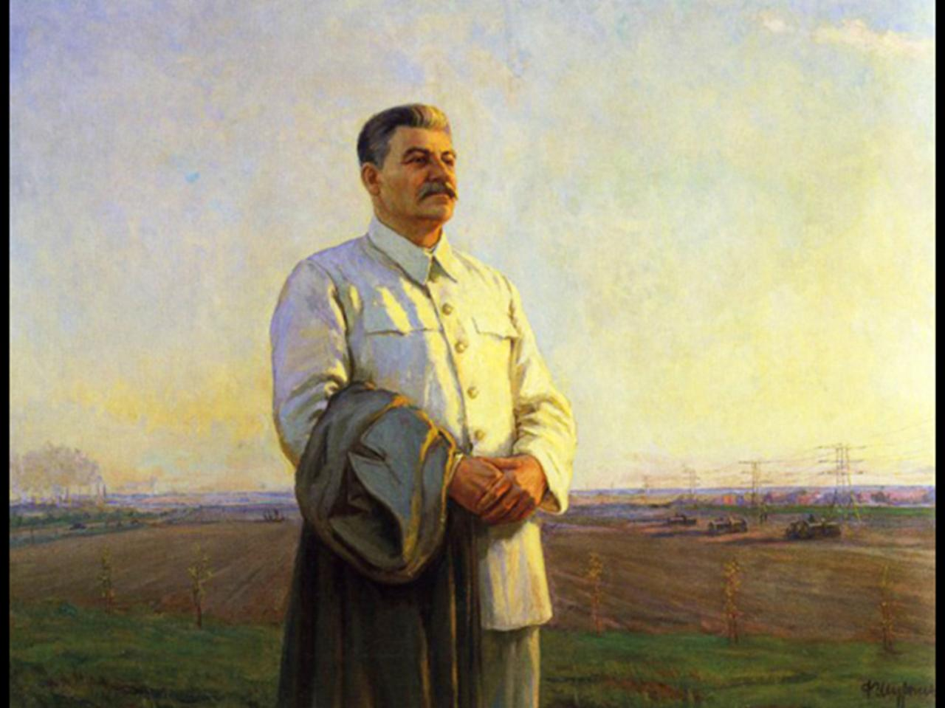

Slide 47
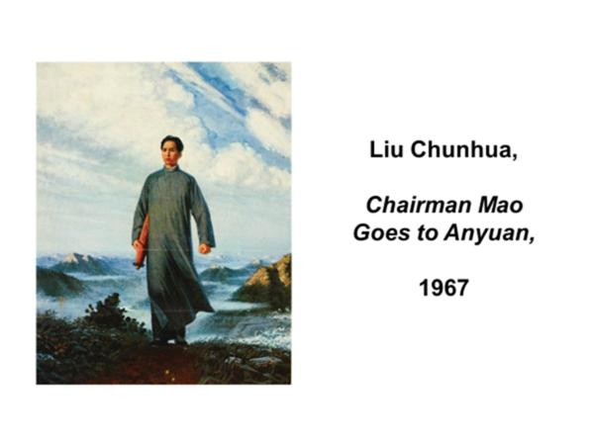

Slide 48
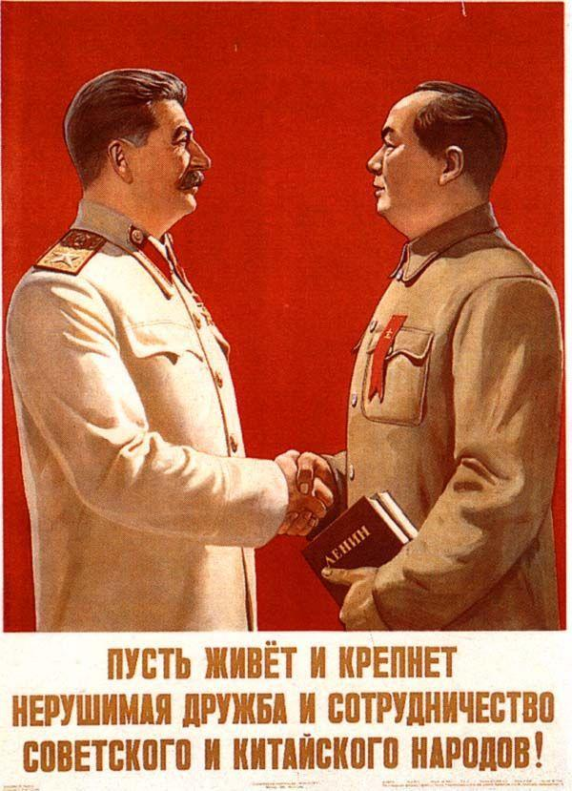

Slide 49
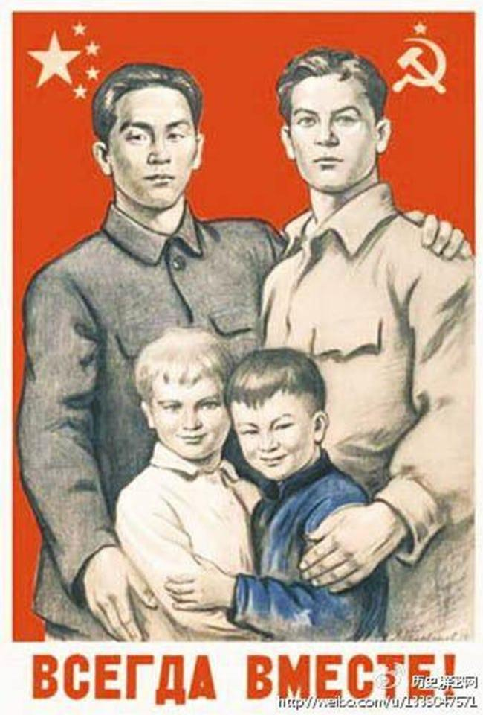

Slide 50
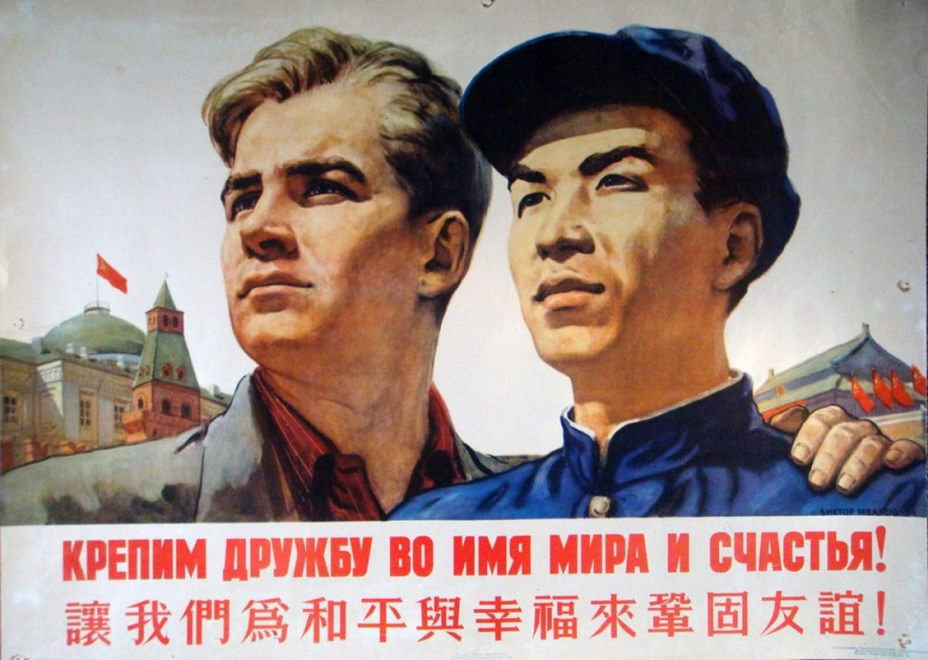

Slide 51
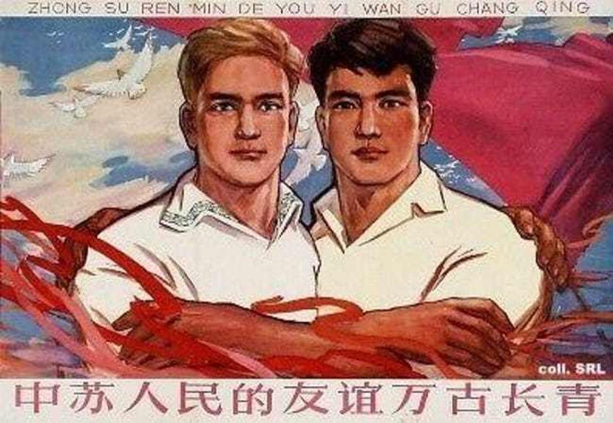

Slide 52
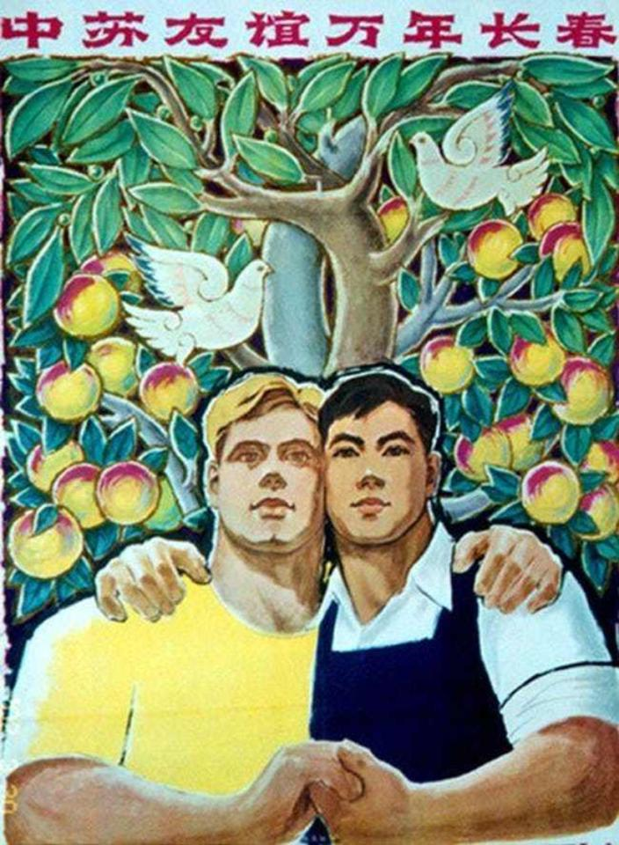

Slide 53
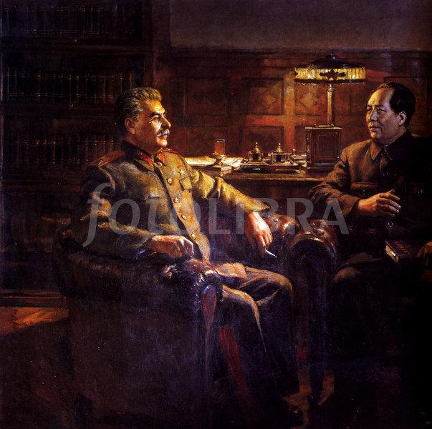

Slide 54

1949

Slide 55

The assimilation, adaptation, and rejection of Soviet aesthetics, 1952 - 1966

Slide 56
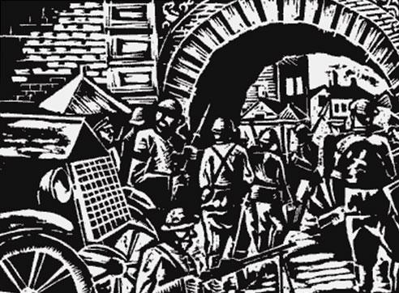

Slide 57
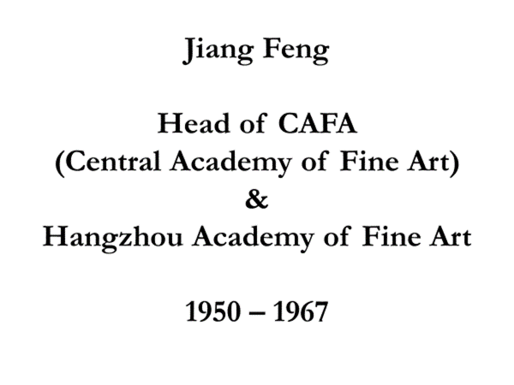

Slide 58
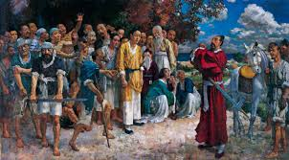

Slide 59


Slide 60



Slide 61


Slide 62


Slide 63


Slide 64


Slide 65


Slide 66


Slide 67

Dong Xiwen, The Founding of the Nation,
1953; oil on canvas, 8’ x 13’

Slide 69
Era of Soviet Assistance 1953-1960
1953 5-Year Plan:
Art education classes in Middle Schools
Chistiakov Drawing Method introduced
80 Soviet/Russian art books published
1954 Blockbuster Soviet Art Exhibition
20 CAFA exchange students study
at Repin Academy, Leningrad
1955 Arrival of Konstantin Maximov

Slide 70


Slide 71


Slide 72

Luo Gongliu, Mao Zedong Reporting on
the Rectification in Yan’an, 1961

Slide 74


Slide 75


Slide 76


Slide 77
Konstantin Maksimov
Chistiakov drawing method

Slide 78


Slide 79


Slide 81



Hou Yimin,
Liu Shaoqi and the Anyuan Coal Miners, 1961

Slide 82


Slide 83


Slide 84


Slide 85


Slide 86


Slide 87


Slide 88


Slide 89


Slide 90


Slide 91
Ai Qing,
“On Chinese Painting,”
1953

Slide 92


Slide 93
“What is wrong with the painters? Is it that they do not understand the demands of the people, they cannot see that times have changed, and that they are unsuitable to this era?
If clothes don’t fit they must be altered so thay they fit when you try them on. If something is unsuitable and is not changed we should abandon it.
-- Ai Qing

Slide 94

Jiang Zhaohe, Refugees, 1942

Slide 95

Jiang Zhaohe,
Selling Thread,
1937

Slide 96
Re-emergence of guohua
1953-1960

Slide 97
Jiang Zhaohe,
Telling Uncle Soldier my Grades,
1953

Slide 98


Slide 99




Slide 100



Slide 101


Slide 102



Slide 103

Shi Lu,
Fighting in
Northern Shaanxi
Ink and color on paper,
1959; 7’ x 8’
Great Hall of the People, Beijing

Slide 105


Slide 106


Slide 107


Slide 108


Slide 109


Slide 110


Slide 111




Slide 112


